Slide 1

Customer Churn Prediction for Retail Loyalty Programs
Saunak Mitra
Sanjeev Kumar Singh
Sandeep Kumar
October 16th, 2024

Slide 2

Agenda
1
Introduction
2
Problem Statement
3
Objectives
4
Dataset Overview
5
Pre-processing & EDA
6
Model Training & Evaluation
7
Results
8
Strategies
9
Conclusion
10
References

Slide 3

Introduction
Telecom churn refers to the phenomenon where customers stop using the services of a telecom companies.
High churn rates can lead to significant revenue loss, increased marketing costs, and a negative brand reputation
Retaining existing customers is more cost-effective than acquiring new ones, making churn prediction a key focus for telecom companies.
Predicting which customers are likely to churn allows companies to take proactive measures.
Effective churn prediction models help design targeted retention strategies

Slide 4

Problem Statement
Customer churn is a major challenge for retail loyalty programs,
leading to revenue loss and reduced customer engagement.
This project aims to develop a predictive model to identify
customers at risk of leaving, allowing for targeted retention
efforts to improve customer loyalty and reduce churn rates.

Slide 5

Objectives
Understanding Churn Drivers
Identifying At-Risk Customers
Improving Decision-Making

Slide 6
Dataset Overview
Source: The dataset contains information from a telecom company providing home phone and internet services to 7,043 customers in California during Q3.
Demographics
Age
Billing & Payment
Monthly Charges
Churn
Yes
Service Details
Gender
City
Marital Status
Total Charges
Contract Type
Payment Method
No
Key Features
Phone Service
Internet Service
Online Security
Device Protection
Streaming TV/Movies.

Slide 7
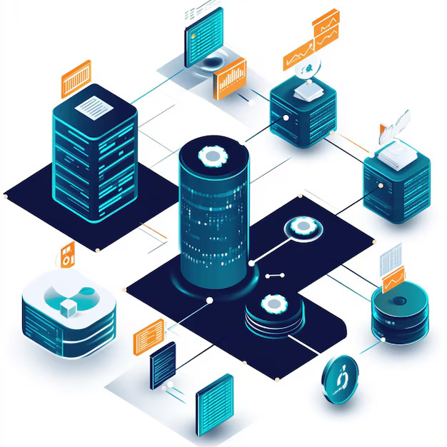
Data Pre-processing
Handled missing values through imputation.
Encoded categorical variables
Applied scaling techniques (Min-Max Scaling or Standardization) to numerical features.
Used SMOTE to generate synthetic samples for the minority class (churned customers).
Removed irrelevant features to enhance model efficiency.

Slide 8
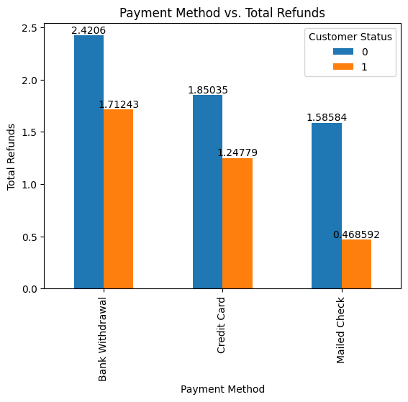
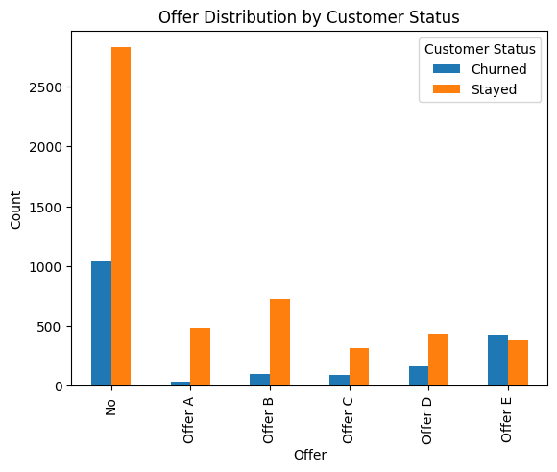
Exploratory Data Analysis

Slide 9
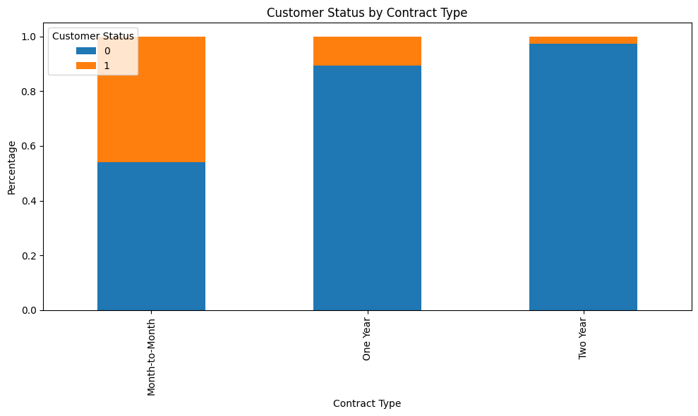
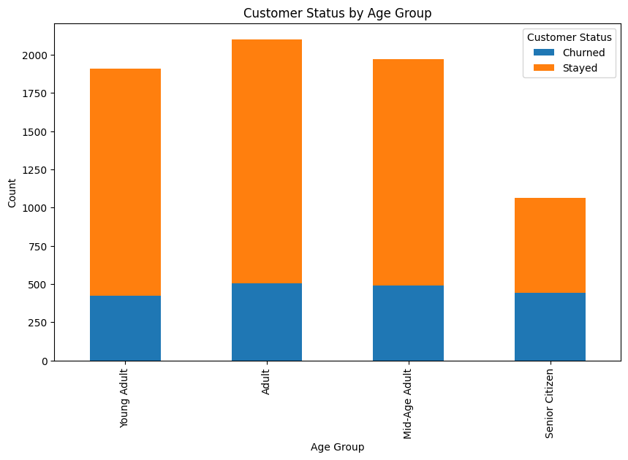
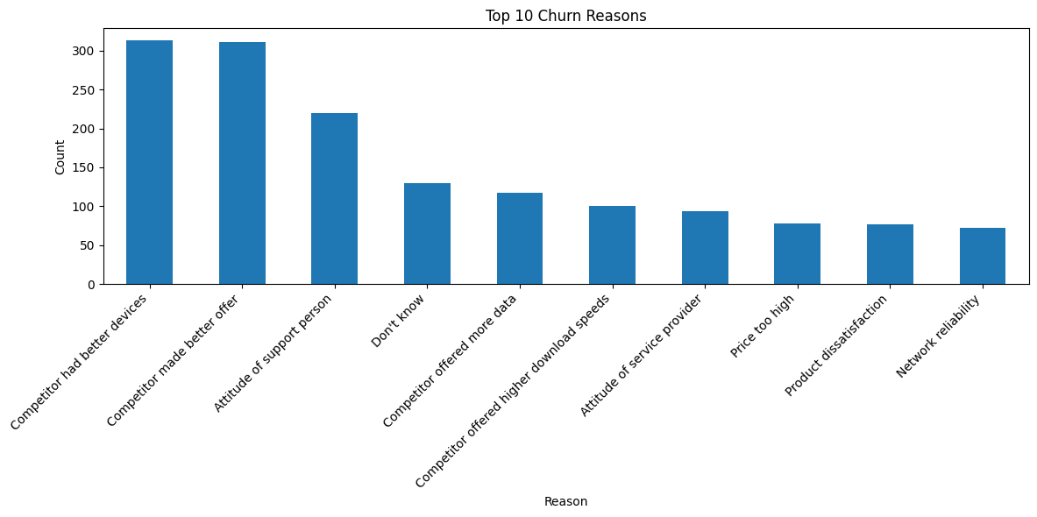

Slide 10
Model Training & Evaluation
Model Training:
Evaluation Metrics:
Logistic Regression
Random Forest
Precision and Recall: Especially useful for imbalanced data like churn prediction.
F1-Score: Harmonic mean of precision and recall, providing a balance between the two.
Confusion Matrix: Helps understand where the model made correct and incorrect predictions.
Trained models using the 80% training dataset.
Used Stratified sampling to divide dataset into homogeneous groups.
Applied SMOTE to address class imbalance
Implemented cross-validation to ensure model robustness and prevent overfitting.
KNN
XGBoost

Slide 11
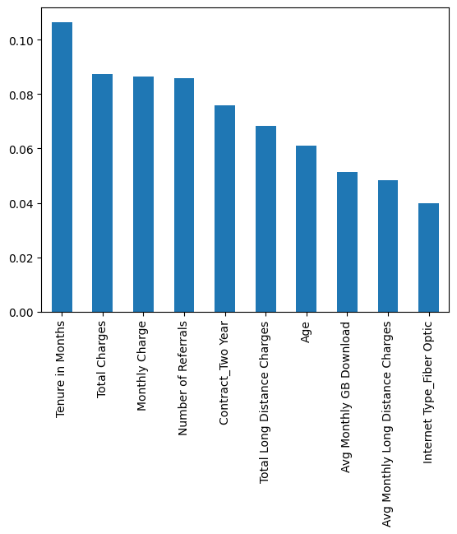
Results
Implemented multiple models: Random Forest, Logistic Regression, XGBoost, KNN and LGBM Classifier.
LGBM Classifier achieved the highest F1 Score of 0.7 among all models.
The cross-validation results confirmed the robustness of the LGBM Classifier.

Slide 12

Strategies
Segment-Based Targeting
Contract Incentives
Early Engagement
Customer Support and Communication
Personalized Offers
Competitive Pricing

Slide 13
Conclusion
1
Effective Churn Prediction: Key factors like contract type, monthly charges, and tenure identified as drivers of churn.
2
Actionable Insights: Provided strategies for customer retention based on data analysis.
3
Loyalty Program Optimization: Recommendations for personalized offers and contract incentives to reduce churn.
4
Business Impact: Enable Proactive measure to enhance customer loyalty and reduce turnover.

Slide 14
References
Kline, R.B. (2011). Principles and practice of structural equation modeling (5th ed., pp. 3-427). New York:The Guilford Press.
Edwards, A. (1976). An introduction to linear regression and correlation. W. H. Freeman.
Everitt, B. S.; Skrondal, A. (2010), The Cambridge Dictionary of Statistics, Cambridge University Press.
Applied Predictive Modeling (by Kuhn & Johnson).
Hands-On Machine Learning with Scikit-Learn, Keras, and TensorFlow (by Aurélien Géron).
Master Machine Learning Algorithms (by Brownlee).
Python Feature Engineering Cookbook (by Galli) .
Imbalanced Classification with Python(by Brownlee).

Slide 15

Thank you

